Slide 1

Resume Builder
(A website)
MANISH SHARMA PRAKHAR AGARWAL RAHUL SAXENA

Slide 2


INDEX
INTRODUCTION
TECHNOLOGY USED
BENEFITS
SCREENSHOTS
CONCLUSION

Slide 3
INTRODUCTION

Slide 4
Why Website ?
Accessibility across devices for users.
Publicly accessible to all the visitors.
Increased flexibility and scalability.
Maintenance headaches removed.
The site doesn’t need to be pre-compiled.

Slide 5
What is Resume Builder ?
It is a website which helps students to get their resume in hand just by filling up a simple form.
The resume is downloadable in PDF format.

Slide 6
Why Resume Builder ?
As placement season of most of the colleges is going to start, making Resume is a very hectic work for all the students. Also, many companies judge the candidature of a student just by his/her Resume. So it is necessary for the student to think beyond the third dimension while making the Resume.

Slide 7
TECHNOLOGY USED

Slide 8

TECHNOLOGY USED

Slide 9
BENEFITS

Slide 10
Benefits
Provides instant resume to individuals.
Reduce tedious work in thinking for resume format for users as per their qualification and requirements.
Provides quick access and affordable.
Students can get their resume in PDF format.

Slide 11
SCREENSHOTS

Slide 12
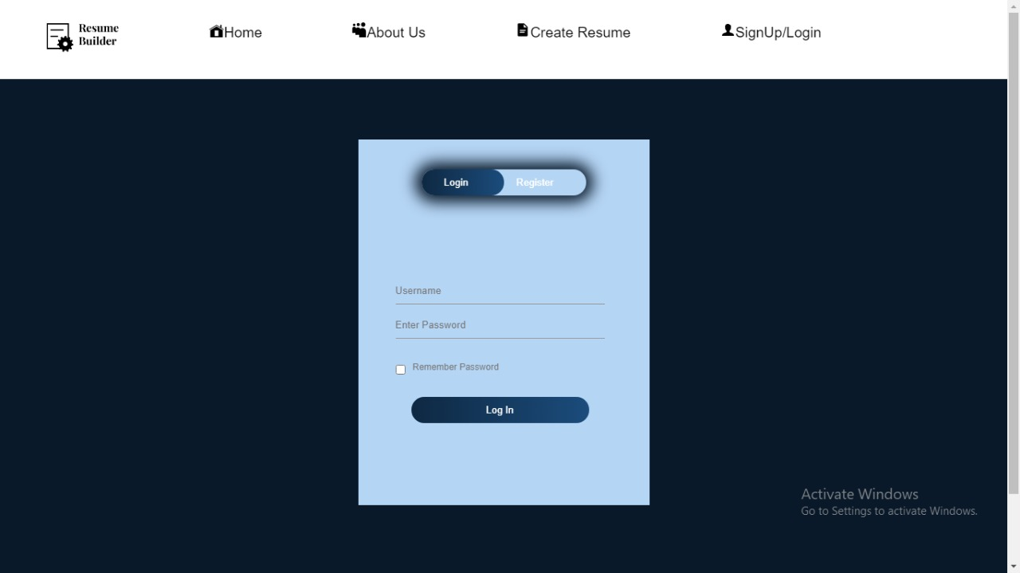
LOGIN PAGE
Navigation drawer
Username input
Password input
Checkbox to remember password
Login Button

Slide 13
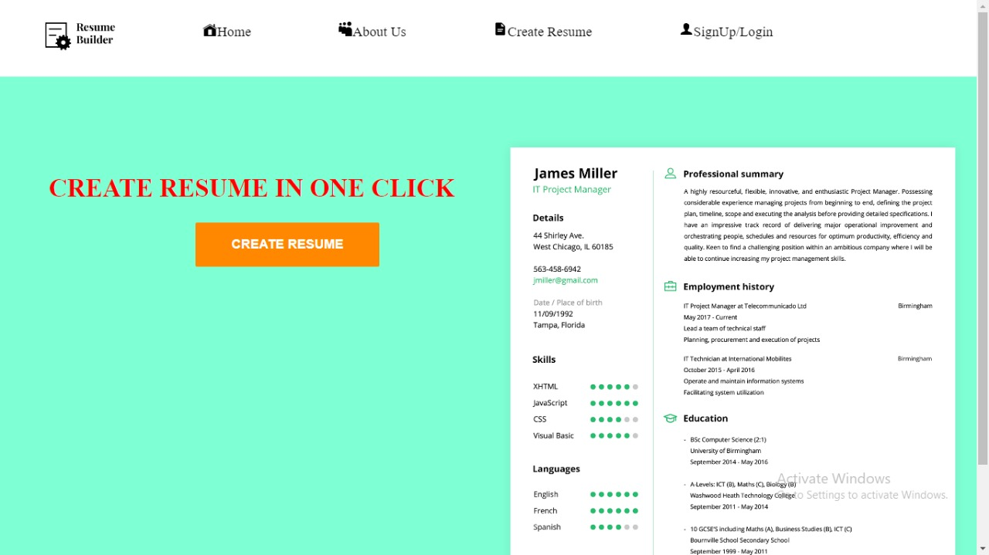
HOME PAGE
Navigation drawer
Button to switch to create resume page
Resume template

Slide 14
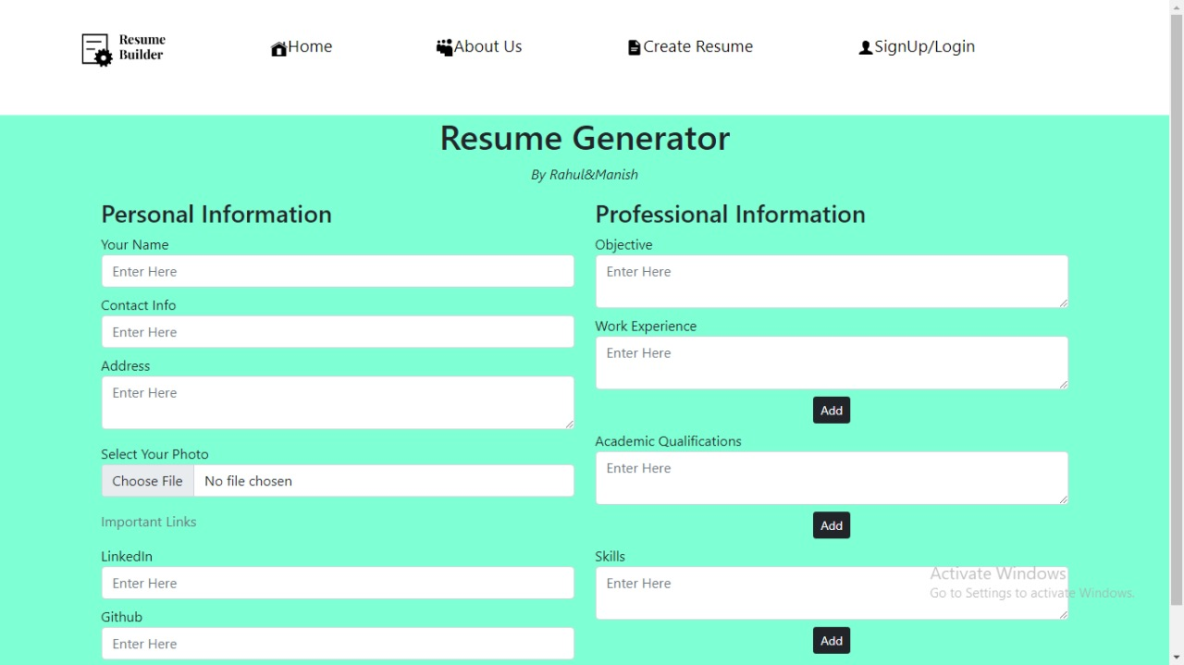
RESUME CREATER PAGE
Navigation drawer
User input for resume

Slide 15

ABOUT PAGE
Navigation drawer
Developer team

Slide 16
CONCLUSION
Whether you are entry-level candidate, an experienced professional, or someone seeking a career change, we are here to help you make your dream a reality.

Slide 17
THANK YOU

